Slide 1
Group H
Dorene Hughes
Nancy Yauneridge
Terri Logan
The Mulhern

Slide 2
Assignment
Identify 4 movie/TV examples that portray computer use in a positive manner.

Slide 3
Disclosure
Michael Douglas & Demi Moore
1994 Thriller about about office politics and intrigue in the computer industry in the mid-1990s.
Defects in DigiCom's new advanced hard drive
Virtual Reality
Merger - millions of dollars made by employees/stockholders
Video: http://bit.ly/jMeByp

Slide 4
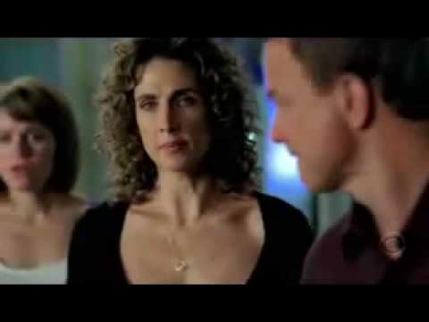
NCIS Naval Criminal Investigative Service
This depicts computer use in the search of large data bases:
DNA
Fingerprints
Phone/credit card use
Personnel/medical files
Chemical analysis
Product availability
https://www.youtube.com/watch?v=hkDD03yeLnU

Slide 5
Connections
All the cool fiction movies are dystopian
Don’t fit the assignment
All the cool stuff about computers is abstract
Doesn’t make a good movie
My best choice: Connections

Slide 6
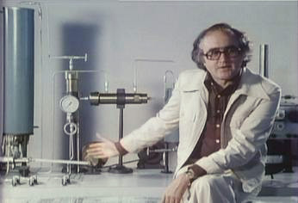
Connections

Slide 7
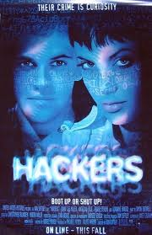
Hackers
A movie teenagers might be interested in
About :
teenagers who “hack”
Bad guy going to steal money using a virus
Kids save the world with hacking
Positive elements:
Kids coming together to solve a problem using computers, programming & computational thinking
Hackers (1995)
107 min
Action | Crime | Drama
Director: Iain Softley
Writer: Rafael Moreu
Stars: Jonny Lee Miller, Angelina Jolie and Jesse Bradford

